Slide 1


Cyber-Warfare
New Canaan Exchange Club
Paul A. Strassmann, July 18, 2017

Slide 2
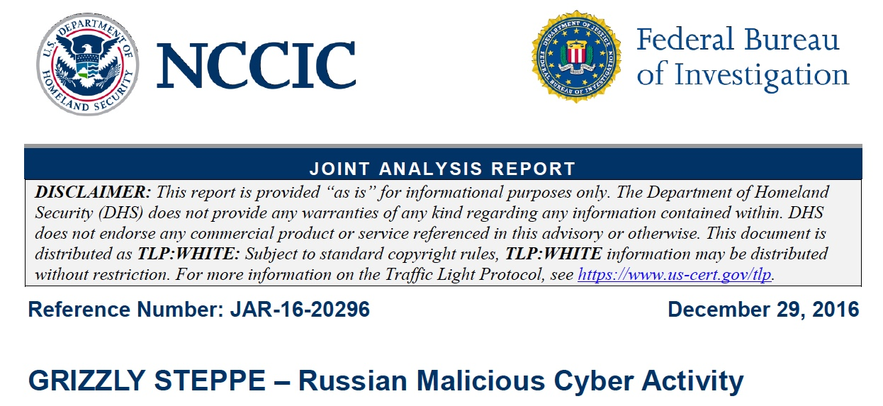
Notifications About Russian Information Warfare

Slide 3
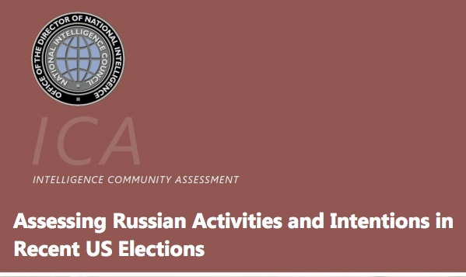
Intelligence Assessments

Slide 4
Russian Cyber-Intrusion Agents – 12/2016
APT29
Agent.btz
BlackEnergy V3
BlackEnergy2 APT
CakeDuke
Carberp
CHOPSTICK
CloudDuke
CORESHEL
COZYBEAR
COZYCAR
COZYDUKE
CrouchingYeti
DIONIS
Dragonfly
Energetic Bear
EVILTOSS
Fancy Bear
GeminiDuke
GREY CLOUD
HammerDuke
HAMMERTOSS
Havex
MiniDionis
.
.
Etc.

Slide 5
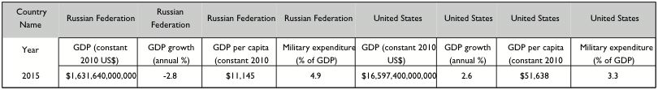
Russia is a Relatively Poor Country, With Large Defense Spending

Slide 6
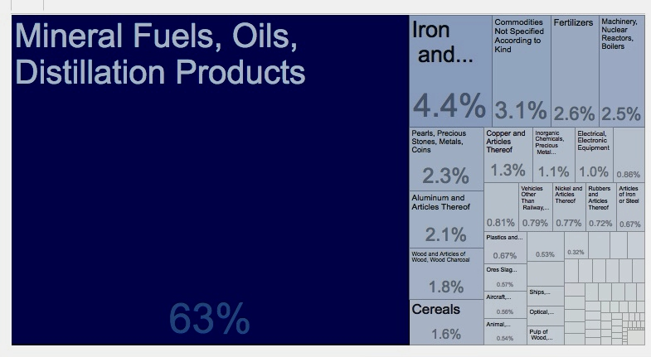
Russia is a Supplier of Raw Materials, Not an Industrial Competitor
2016 exports from the Russian Federation - % of total

Slide 7
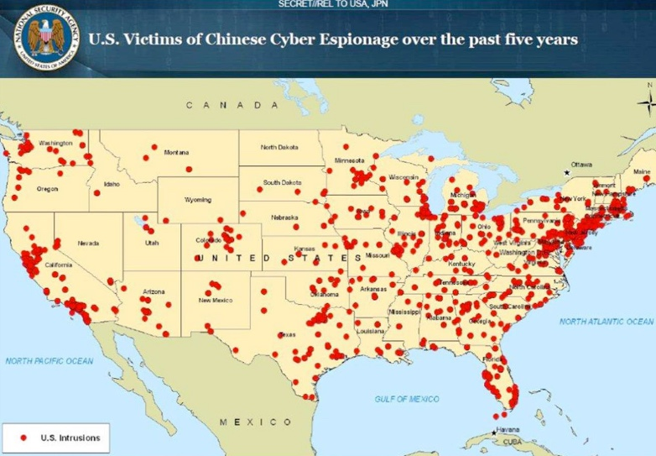
China Also Involved in Cyber Espionage

Slide 8
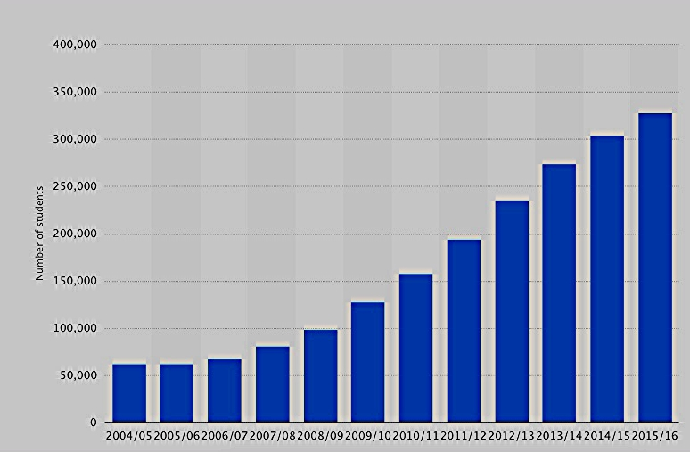
Number of Chinese Students in the USA

Slide 9
Estimated Costs of Defenses
Global cost of cyber incidents grows from $3 trillion in 2015 to $6 trillion by 2021.
Global GDP (2016) is $76.6 trillion.
Cyber/GDP appx. 5%

Slide 10
What is Cyber Warfare
Attacks Received: Millions/day. Must counter all. Attacker costs: close to zero.
Defenses: Very Few. Must intercept every one.
Defender costs: Estimated at >5% of GNP.

Slide 11
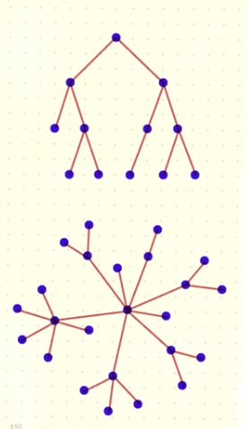
Defending Simple Networks

Slide 12

Present Networks Can Be Hacked

Slide 13

Billions Interconnections on Global Internet

Slide 14
What Are Causes of Vulnerability?
System design flaws.
Errors in computer code.
Unauthorized access privileges.

Slide 15
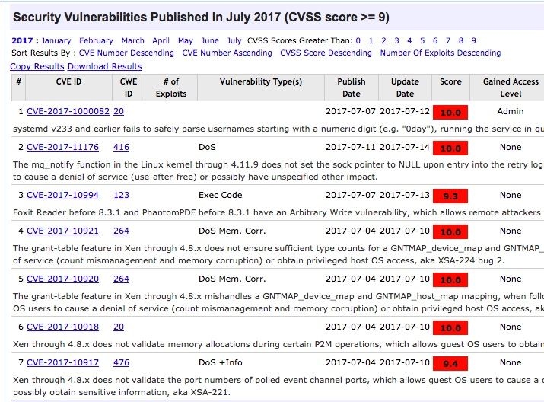
List of Critical Vulnerabilities (CVE >9)

Slide 16
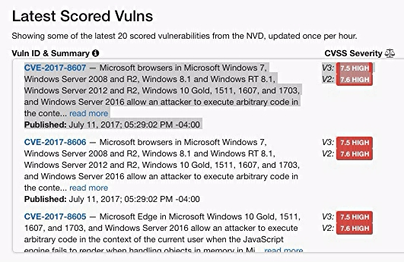
Common Vulnerability Ratings for Microsoft

Slide 17
Bug Bounty Awards
Bug bounty programs offer compensation for reporting bugs pertaining to security exploits and vulnerabilities.
These programs allow developers to discover and resolve bugs before the public is aware, e.g. Zero Day Exploits.
Bug bounty programs have been implemented by Mozilla, Facebook, Yahoo!, Google, Reddit and Microsoft.
The "Hack the Pentagon" program ran for a month. Over 1,400 people submitted 138 unique bugs.

Slide 18
What Do Cyber Defenders Protect?
Potential destinations of cyber attack: >200 million.
Potential paths for cyber attack: > 200 trillion.

Slide 19
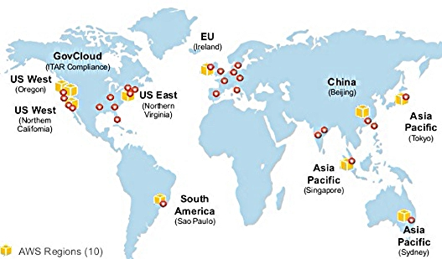
Protection: Operate Multiple Data Centers

Slide 20
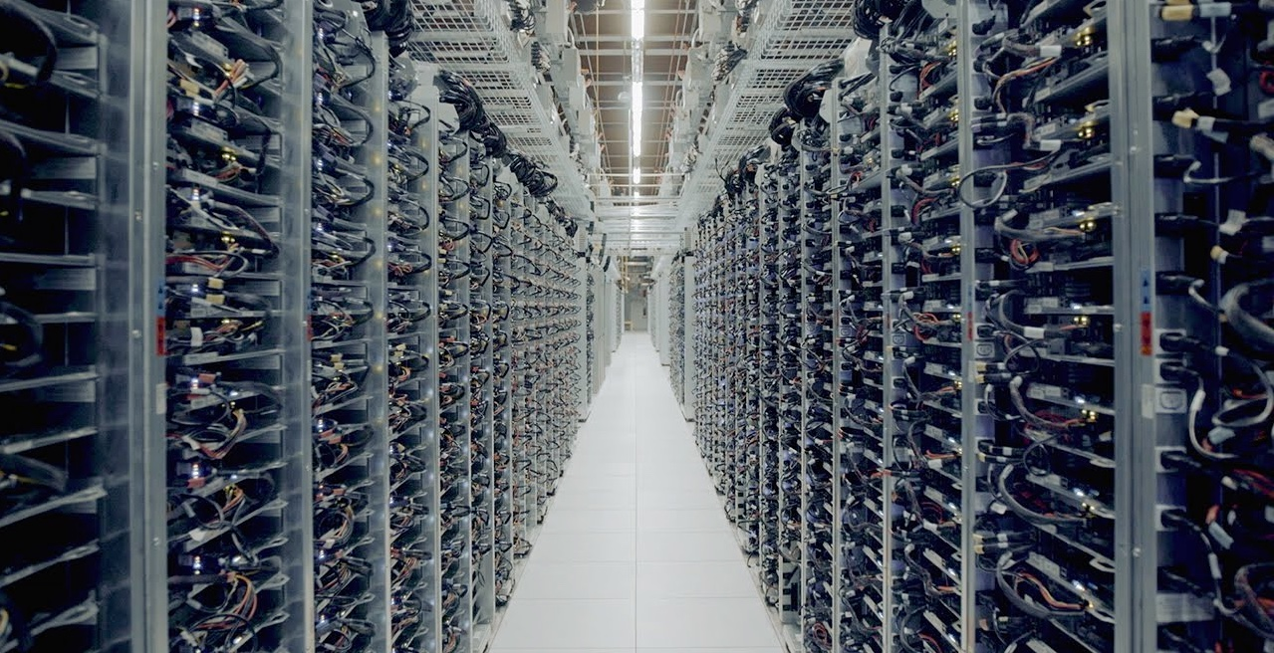
Secure Data Centers Cost >$1 billion

Slide 21
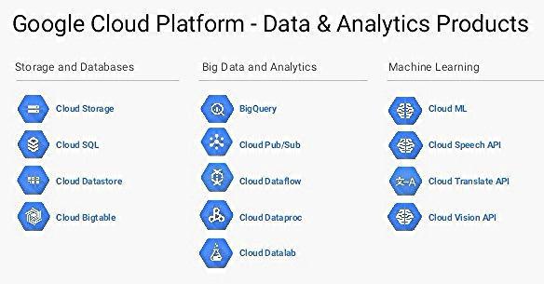
Offer Secure Software

Slide 22

Hacker July 22-27, 2017 Meeting

Slide 23
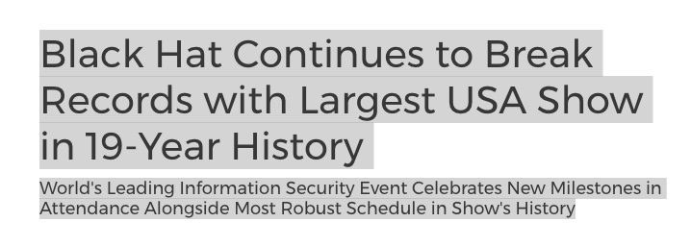
15,000+ Attendance at 2016 Black Hat Conference
Black Hat Arsenal offers demonstration of tools.
Features 80 tools.

Slide 24
Sponsors and Locations of 2016 Black Hat Conference
FireEye, Forcepoint, Hewlett Packard Enterprise, LogRhythm,
Qualys, RSA, Tenable Network Security, AlienVault, Carbon Black, Cisco,
Citrix Systems, CrowdStrike, Cylance, Digital Guardian, Fidelis Cybersecurity,
Fortinet, Lockheed Martin Corporation, Palo Alto Networks, Symantec,
Webroot, CloudPassage, Code42 Software, Core Security, Dark Matter,
F5 Networks, IBM, iboss Cybersecurity, Optiv Security, Proofpoint, Inc.,
Raytheon Foreground Security, SentinelOne and Tripwire.
Black Hat Europe 2016, London, England, November 1-4, 2016
Black Hat Asia 2017, Singapore, March 28-31, 2017
Black Hat USA 2017, Las Vegas, NV, July 22-27, 2017

Slide 25
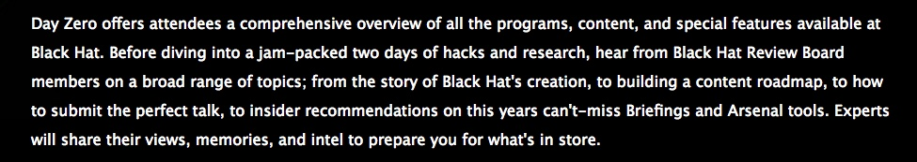
Zero Day at Black Hat

Slide 26
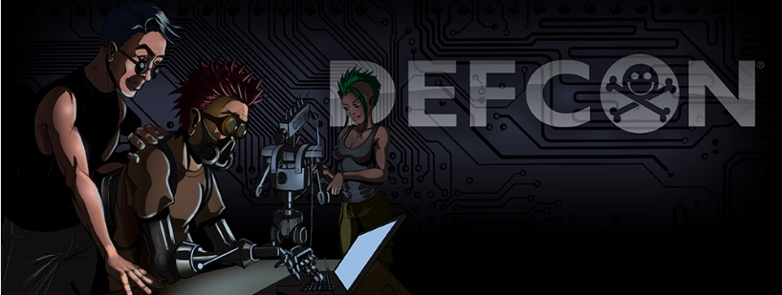
DEFCON Hacking Conference, July 27 to July 30, 2017

Slide 27
DEF CON – 2016 Attendance of 22,000
DEF CON is the world's largest hacking conference.
Hackers, IT professionals and security firms discuss cutting edge research.
Includes security security professionals, journalists, lawyers, federal government employees, security researchers, students, and active hackers.

Slide 28
What to Do: Convert to Managed “Cloud” Computing Services
Place applications on secure cloud services.
Own and operate secure data centers
Use only secured infrastructure software.

Slide 29
Findings
Cyber-warfare is an existential threat.
Current networks cannot be defended.
Increase cyber defense budget to 20% of IT.

Slide 30
Strassmann IDC papers

Slide 31
IT Security: Password Policy and Management DC Study Available ($), March 2016
Dealing with Cyberextortion IDC Study Available ($), May 2015
Fundamental Elements of Effective Cyberdefense IDC Study Available ($), April 2015
Countering Cyberespionage IDC Study Available ($), April 2015
U.S. Government Organizations Supporting Defense Against Cyberthreats IDC Study Available ($), March 2015
Participation in Cyberthreat Information Sharing Centers IDC Study Available ($), March 2015
Director's Oversight of Cyberthreat Protection IDC Study Available ($), February 2015
The CIO's Role in Protecting the Enterprise from Cyberattacks IDC Study Available ($), February 2015
Leadership Guide — Looking to Cloud Networks for Cybersecurity IDC Study Available ($), December 2014
Leadership Guide — Partnerships for Sharing About Cyberthreats IDC Study Available ($), December 2014
Leadership Guide — Detecting Hidden Malware IDC Study Available ($), November 2014
Role of the National Vulnerability Database in Choosing Cyberprotection Vendors IDC Study Available ($), October 2014
Security of Public Cloud Services IDC Study Available ($), September 2014
The Affordability of Cyberdefense Spending IDC Study Available ($), August 2014
Improving Cybersecurity Infrastructure A Practical Approach IDC Study Available ($), June 2014
The Scope of Cyberthreats IDC Study Available ($), May 2014
Eliminating Primary Causes of Cyber Vulnerability IDC Study Available ($), May 2014
Securing Mobile Devices for the Enterprise IDC Study Available ($), March 2014
Defending Against Internet Incursions IDC Study Available ($), March 2014
IDC Maturity Model: IT Security IDC Study Available ($), March 2014
IT Security: Password Policy and Management, IDC Study Available ($), November 2013
Executive Guide to Cybercriminals and Their Methods of Attack. IDC Study Available ($), September 2013
The Executive Guide to Protecting Platform-as-a-Service Computing, IDC Study Available ($), September 2013
Using Big Data for Enterprise Security, IDC Study Available ($), August 2013
The Executive Guide to Distributed Denial of Service, IDC Study Available ($), July 2013
Executive Guide to Cyberthreats. IDC Study Available ($), July 2013
IDC Warned about a Snowden-Like Event. IDC Insights, June 2013
The Executive Role in Cyber-Regulations. IDC Study Available ($), June 2013
Countering Software Robots, IDC Study Available ($), May 2013
Insider Theft of Intellectual Property, IDC Study Available ($), April 2013
Top Management's Responses to Cyberattacks, IDC Study Available ($), April 2013
Insider Threats Through IT Sabotage, IDC Study Available ($), January 2013

